Slide 1

Notes:
Reload codespace
Update settings.json.
Uncheck VS Code tabs except for Terminal
Hide Activity Bar
Hide Explorer
Remove comments from any pre-made code

Slide 2
data structures

Slide 3
abstract data types

Slide 4
queues
Notes:
- waiting in line

Slide 5
FIFO

Slide 6
enqueue
dequeue

Slide 7
const int CAPACITY = 50;
typedef struct
{
person people[CAPACITY];
int size;
} queue;

Slide 8
stacks
Notes:
- stack of sweaters
- Gmail inbox

Slide 9
LIFO

Slide 10
push
pop

Slide 11
typedef struct
{
person people[CAPACITY];
int size;
} stack;

Slide 12
const int CAPACITY = 50;
typedef struct
{
person people[CAPACITY];
int size;
} stack;

Slide 13
Notes:
https://www.youtube.com/watch?v=ItAG3s6KIEI
Prof. Shannon Duvall of Elon University

Slide 15
arrays

Slide 17
 | 1 | 2 | 3

Slide 18
 | 1 | 2 | 3

Slide 19
 | 1 | 2 | 3

Slide 20

 | 1 | 2 | 3 | h | e | l | l
o | , |  | w | o | r | l | d
\0

Slide 21
 | 1 | 2 | 3

Slide 22
 | 1 | 2 | 3
 | 1

Slide 23
 | 1 | 2 | 3
 | 1 | 2

Slide 24
 | 1 | 2 | 3
 | 1 | 2 | 3

Slide 25
 | 1 | 2 | 3
 | 1 | 2 | 3 | 4

Slide 26
 | 1 | 2 | 3 | 4
Notes:
list{0,1,2}.c

Slide 27
data structures

Slide 28
struct
.
*

Slide 29
struct
->

Slide 30
linked lists

Slide 32
 |  | 1 0x123

Slide 33
 |  | 1 0x123
 |  |  |  | 2 0x456

Slide 34
 |  | 1 0x123
 |  |  |  | 2 0x456
 |  |  |  |  |  | 3 0x789

Slide 35
 |  | 1 0x123
 |  |  |  | 2 0x456
 |  |  |  |  |  | 3 0x789

Slide 36
 |  | 1 0x123
 |  | 0x456 |  | 2 0x456
 |  |  |  |  |  | 3 0x789

Slide 37
 |  | 1 0x123
 |  | 0x456 |  | 2 0x456
 |  |  |  | 0x789 |  | 3 0x789

Slide 38
 |  | 1 0x123
 |  | 0x456 |  | 2 0x456
 |  |  |  | 0x789 |  | 3 0x789
 |  |  |  |  |  | 0x0
NULL

Slide 39
 |  | 1 0x123
 |  | 0x456 |  | 2 0x456
 |  |  |  | 0x789 |  | 3 0x789
 |  |  |  |  |  | NULL

Slide 40
 |  | 1 0x123
 |  | 0x456 |  | 2 0x456
0x123 |  |  |  | 0x789 |  | 3 0x789
 |  |  |  |  |  | NULL

Slide 41
 |  | 1
 |  |  |  | 2
 |  |  |  |  |  | 3

Slide 42
typedef struct
{
string name;
string number;
} person;

Slide 43
typedef struct
{
char *name;
char *number;
} person;

Slide 44
typedef struct
{
} person;

Slide 45
typedef struct
{
} node;

Slide 46
typedef struct
{
int number;
} node;

Slide 47
typedef struct
{
int number;
node *next;
} node;
how can we use node before defining node?

Slide 48
typedef struct node
{
int number;
node *next;
} node;
give me a type definition for a structure called node

Slide 49
c code is read from top to bottom
typedef struct node
{
int number;
struct node *next;
} node;
this structure is named “struct node”
can now be referred to below its declaration
can also be referred to by its declared synonym

Slide 51
node *list;

Slide 52
node *list;
bad. initialized to garbage value
list

Slide 53
node *list = NULL;
initialize linked list’s head pointer as NULL
list
0x0

Slide 54
node *n = malloc(sizeof(node));
list

Slide 55
node *n = malloc(sizeof(node));
list
initialize node of linked list pointer as node sized memory allocation
n

Slide 56
node *n = malloc(sizeof(node));
list
number
n
next

Slide 57
node *n = malloc(sizeof(node));
list
number
n
next

Slide 58
(*n).number = 1;
list
number
n
next

Slide 59
(*n).number = 1;
list
1
number
n
next

Slide 60
n->number = 1;
(*n).number = 1; //equivalent code
list
1
number
n
next

Slide 61
n->next = NULL;
list
1
number
n
remove garbage
next

Slide 62
n->next = NULL;
list
1
number
n
next

Slide 63
list = n;
list
1
number
n
next

Slide 64
list = n;
we initialize node with a temporary pointer so we have a way to connect its parent
list
1
number
n
next

Slide 65
list
1

Slide 66
node *n = malloc(sizeof(node));
list
1

Slide 67
node *n = malloc(sizeof(node));
list
1
n

Slide 68
node *n = malloc(sizeof(node));
list
1
n

Slide 69
node *n = malloc(sizeof(node));
list
1
n

Slide 70
n->number = 2;
list
1
n

Slide 71
n->number = 2;
list
2
1
n

Slide 72
n->next = NULL;
list
2
1
n

Slide 73
n->next = NULL;
list
2
1
n

Slide 74
list
2
1
n

Slide 75
list = n;
list
2
1
n

Slide 76
list = n;
list
2
wrong
we have lost all references to this node
1
n
when child node is “orphaned”, then we have a memory leak

Slide 77
list = n;
list
2
wrong
we have lost all references to this node
1
n
when child node is “orphaned”, then we have a memory leak

Slide 78
list
2
1
n

Slide 79
n->next = list;
list
2
1
n

Slide 80
n->next = list;
list
2
1
n

Slide 81
list = n;
list
2
1
n

Slide 82
list = n;
list
2
1
n

Slide 83
list
2
1

Slide 84
list
2
1
3
Notes:
start list3.c

Slide 85
ptr
list
2
1
3

Slide 86
ptr
list
2
1
3

Slide 87
ptr
list
2
1
3

Slide 88
ptr
list
2
1
3
Notes:
finish list3.c
list4.c

Slide 89
list
2
1
3

Slide 90
O(n²)
O(n log n)
O(n)
O(log n)
O(1)

Slide 92
list

Slide 93
list
1

Slide 94
list
2
1

Slide 95
list
2
1
3

Slide 97
list

Slide 98
list
1

Slide 99
2
list
1

Slide 100
2
list
1
3
Notes:
mention list5.c

Slide 101
O(n²)
O(n log n)
O(n)
O(log n)
O(1)
time to search linked-list
time to insertion into unordered linked-list

Slide 103
list

Slide 104
list
2

Slide 105
list
2
1

Slide 106
4
list
2
1

Slide 107
4
list
2
3
1
Notes:
mention list6.c

Slide 108
O(n²)
O(n log n)
O(n)
O(log n)
O(1)

Slide 109


Slide 110
trees

Slide 111
binary search trees

Slide 112
 | 1 | 2 | 3 | 4 | 5 | 6 | 7

Slide 113
 | 1 | 2 | 3 | 4 | 5 | 6 | 7

Slide 114
 | 1 | 2 | 3 | 4 | 5 | 6 | 7

Slide 115
 | 1 | 2 | 3 | 4 | 5 | 6 | 7

Slide 116
4
2
6
1
3
5
7

Slide 117
4
2
6
1
3
5
7
Notes:
each square is an abstraction of a node now, no need to keep drawing rects

Slide 118
typedef struct node
{
int number;
struct node *next;
} node;

Slide 119
typedef struct node
{
int number;
} node;

Slide 120
typedef struct node
{
int number;
} node;

Slide 121
typedef struct node
{
int number;
struct node *left;
struct node *right;
} node;

Slide 122
4
2
6
1
3
5
7

Slide 123
bool search(node *tree, int number)
{
if (tree == NULL)
{
return false;
}
else if (number < tree->number)
{
return search(tree->left, number);
}
else if (number > tree->number)
{
return search(tree->right, number);
}
else if (number == tree->number)
{
return true;
}
}

Slide 124
bool search(node *tree, int number)
{
if (tree == NULL)
{
return false;
}
else if (number < tree->number)
{
return search(tree->left, number);
}
else if (number > tree->number)
{
return search(tree->right, number);
}
else if (number == tree->number)
{
return true;
}
}

Slide 125
bool search(node *tree, int number)
{
if (tree == NULL)
{
return false;
}
else if (number < tree->number)
{
return search(tree->left, number);
}
else if (number > tree->number)
{
return search(tree->right, number);
}
else if (number == tree->number)
{
return true;
}
}

Slide 126
bool search(node *tree, int number)
{
if (tree == NULL)
{
return false;
}
else if (number < tree->number)
{
return search(tree->left, number);
}
else if (number > tree->number)
{
return search(tree->right, number);
}
else if (number == tree->number)
{
return true;
}
}

Slide 127
bool search(node *tree, int number)
{
if (tree == NULL)
{
return false;
}
else if (number < tree->number)
{
return search(tree->left, number);
}
else if (number > tree->number)
{
return search(tree->right, number);
}
else if (number == tree->number)
{
return true;
}
}

Slide 128
bool search(node *tree, int number)
{
if (tree == NULL)
{
return false;
}
else if (number < tree->number)
{
return search(tree->left, number);
}
else if (number > tree->number)
{
return search(tree->right, number);
}
else if (number == tree->number)
{
return true;
}
}

Slide 129
4
2
6
1
3
5
7

Slide 130
Notes:
What if we build a BST from scratch, starting with 2?

Slide 131
2

Slide 132
2
1
Notes:
then 1

Slide 133
2
1
3
Notes:
then 3. looks fine.

Slide 134
Notes:
what if the insertion order is 1-2-3 instead?

Slide 135
1

Slide 136
1
2

Slide 137
1
2
3

Slide 138
O(n²)
O(n log n)
O(n)
O(log n)
O(1)

Slide 139
dictionaries

Slide 141
word | definition

Slide 142
key | value

Slide 143

Notes:
https://apps.apple.com/us/app/contacts/id1069512615#?platform=iphone

Slide 144
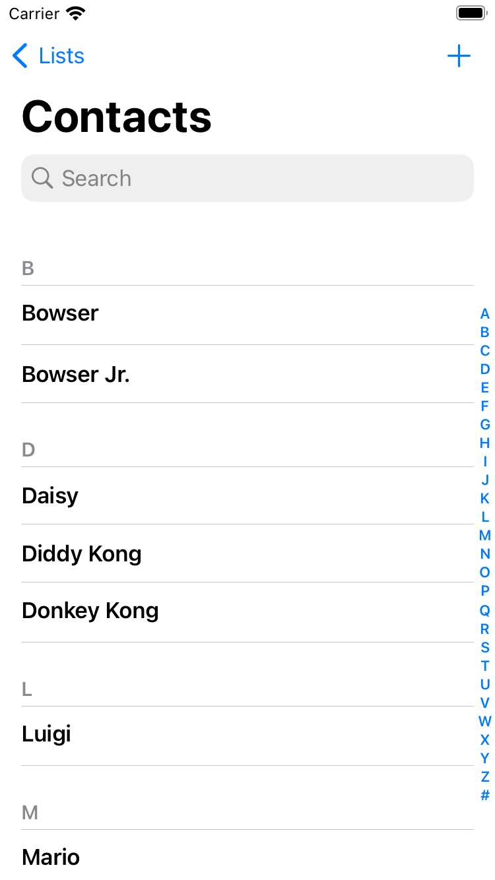
Notes:
https://nintendo.fandom.com/wiki/Nintendo_characters#Mario_series_(including_sub-franchises)

Slide 145


Slide 146
name | number

Slide 147
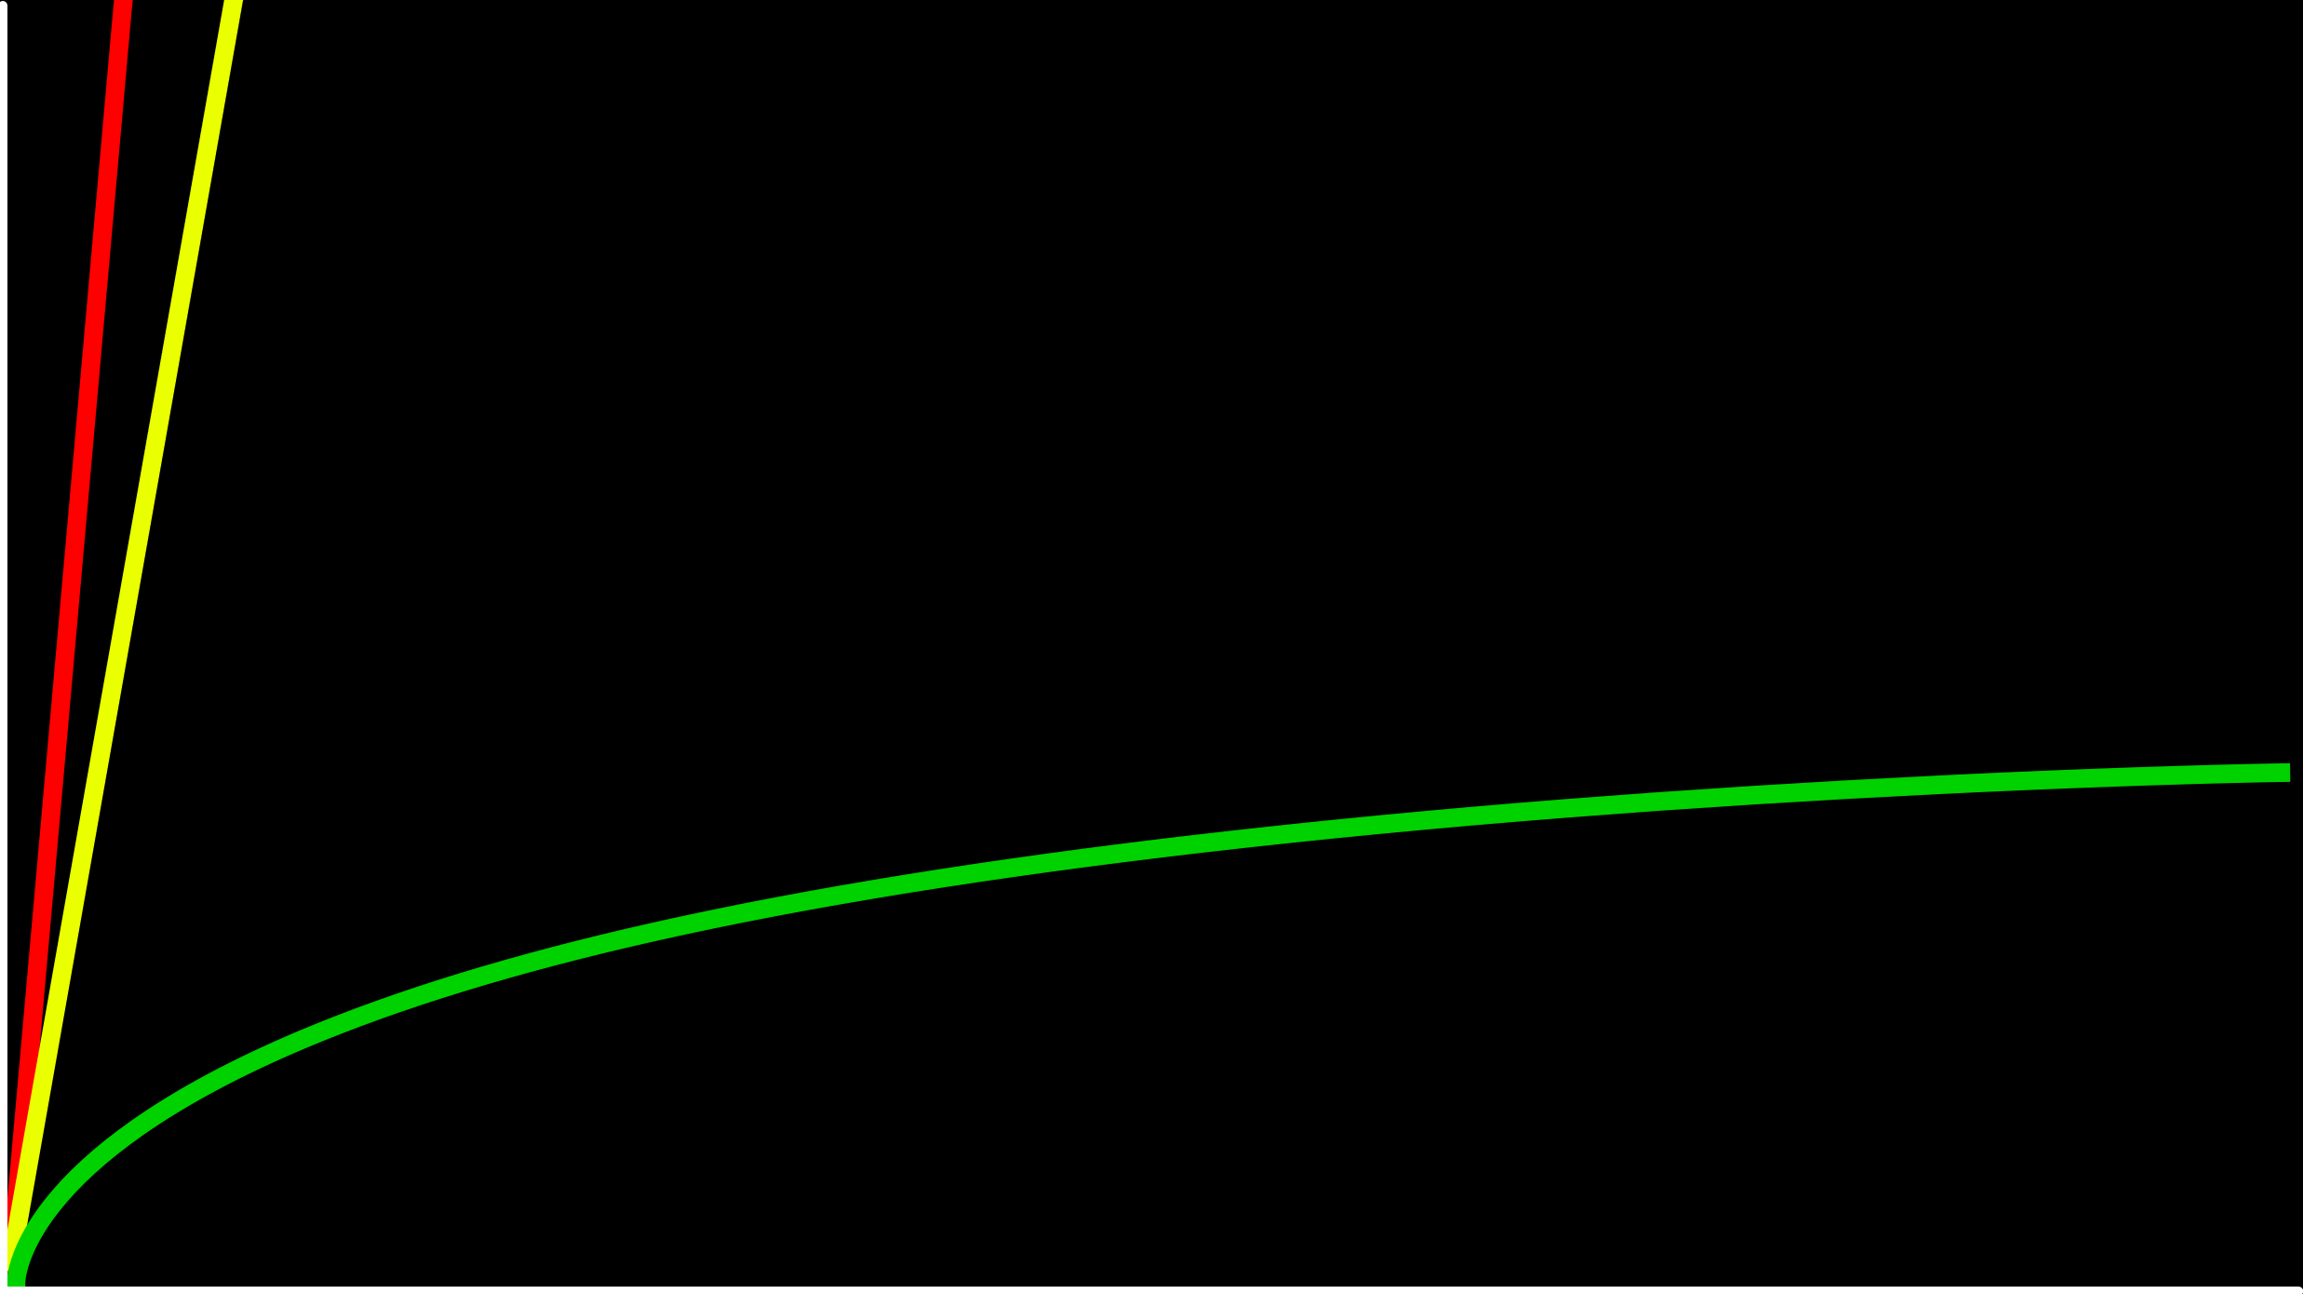
O(n)
time to solve
O(log n)
size of problem

Slide 148
O(n)
time to solve
O(log n)
O(1)
size of problem

Slide 149
hashing
Notes:
cards into buckets

Slide 150
hash function

Slide 151
hash tables

Slide 153
0
1
2
3
4
5
6
7
8
9
10
11
12
13
14
15
16
17
18
19
20
21
22
23
24
25

Slide 154
A
B
C
D
E
F
G
H
I
J
K
L
M
N
O
P
Q
R
S
T
U
V
W
X
Y
Z

Slide 156
Mario

Slide 157
Luigi
Mario

Slide 158
Luigi
Mario
Peach

Slide 159
Birdo
Daisy
Goomba
Isabelle
King Boo
Luigi
Mario
Peach
Rosalina
Shy Guy
Toad
Wario
Yoshi
Zelda

Slide 160
Birdo
Daisy
Goomba
Isabelle
King Boo
Luigi
Lakitu
Mario
Peach
Rosalina
Shy Guy
Toad
Wario
Yoshi
Zelda

Slide 161
Birdo
Daisy
Goomba
Isabelle
King Boo
Luigi
Lakitu
Link
Mario
Peach
Rosalina
Shy Guy
Toad
Wario
Yoshi
Zelda

Slide 162
Birdo
Bowser
Bowser Jr.
Daisy
Donkey Kong
Diddy Kong
Dry Bones
Goomba
Ganon
Isabelle
King Boo
K.K. Slider
Luigi
Lakitu
Link
Mario
Peach
Petey Piranha
Rosalina
Shy Guy
Spike
Toad
Toadette
Tom Nook
Wario
Waluigi
Yoshi
Zelda

Slide 163
O(n²)
O(n log n)
O(n)
O(log n)
O(1)

Slide 164
typedef struct
{
char *name;
char *number;
} person;

Slide 165
typedef struct node
{
char *name; char *number;
struct node *next;
} node;

Slide 166
node *table[26];

Slide 167
input →
→ output

Slide 168
hash function

Slide 169
Mario →
→ 12

Slide 170
Luigi →
→ 11

Slide 171
Laa
Lab
Lac
Lad
Lae
Laf
Lag
Lah
Lai
Laj
Lak
...
Lim
Lin
Lio
...
Luh
Lui
Luj
Lakitu
Link
Luigi
Notes:
17,576 buckets

Slide 172
#include <ctype.h>
int hash(char *word)
{
return toupper(word[0]) - 'A';
}

Slide 173
#include <ctype.h>
int hash(const char *word)
{
return toupper(word[0]) - 'A';
}
error handling
tells compiler not to allow changes to string passed in by reference

Slide 174
#include <ctype.h>
unsigned int hash(const char *word)
{
return toupper(word[0]) - 'A';
}
error handling
we know locations in array is never positive

Slide 175
O(n)

Slide 176
O(n/k)
k is number of buckets
in best case scenario where first letters of all contacts are uniformly distributed

Slide 177
O(n)
asymptotically, O(n/k) = O(n) given k is constant

Slide 178
O(1)

Slide 179
tries
hash table is an array of linked lists
trie is a tree of arrays
both can be used to implement a dictionary eg. key:value pairs
short for retrieval

Slide 180
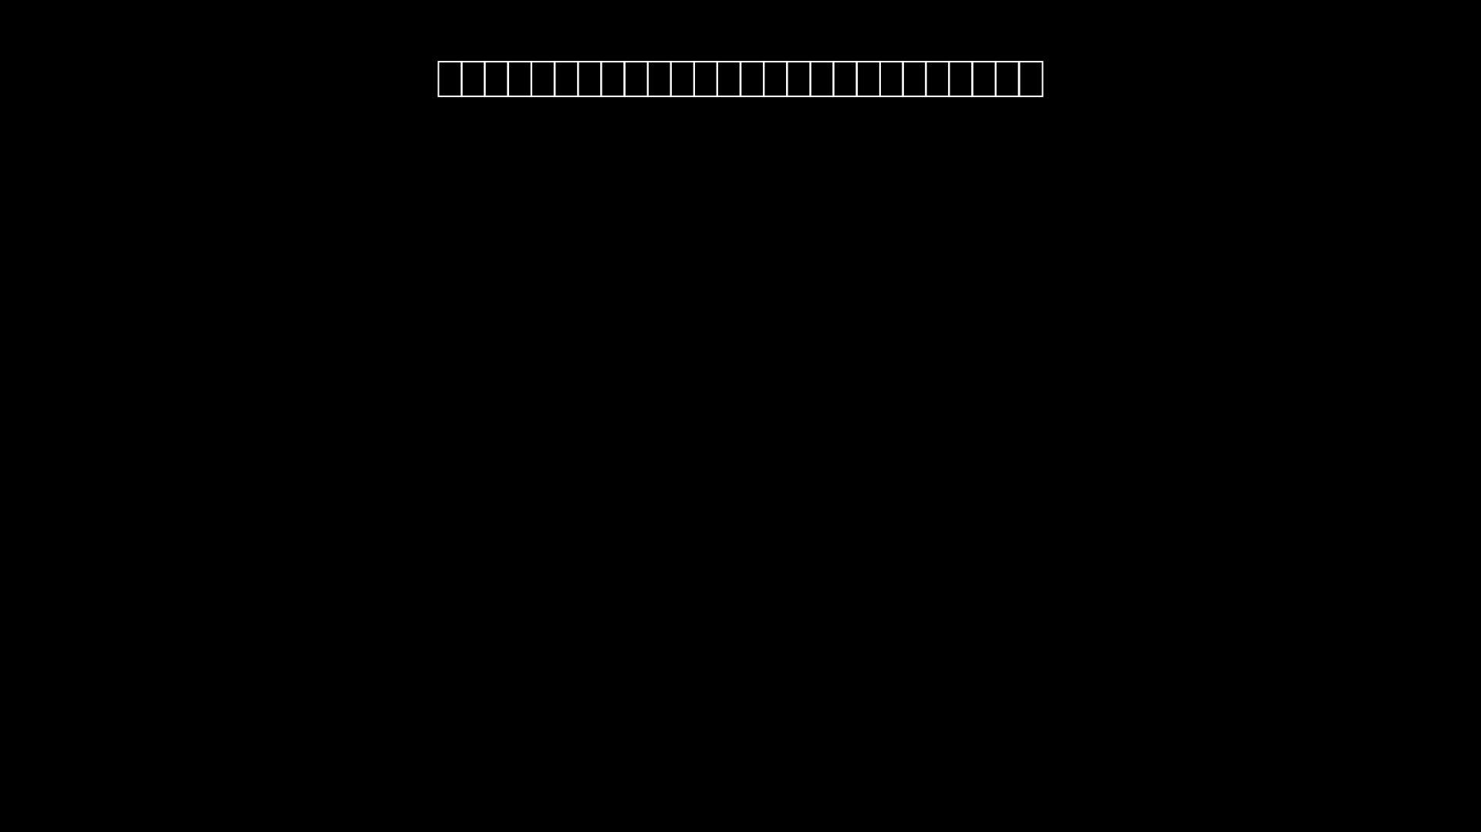
every node is an array
every location in any array will represent a letter of alphabet

Slide 181
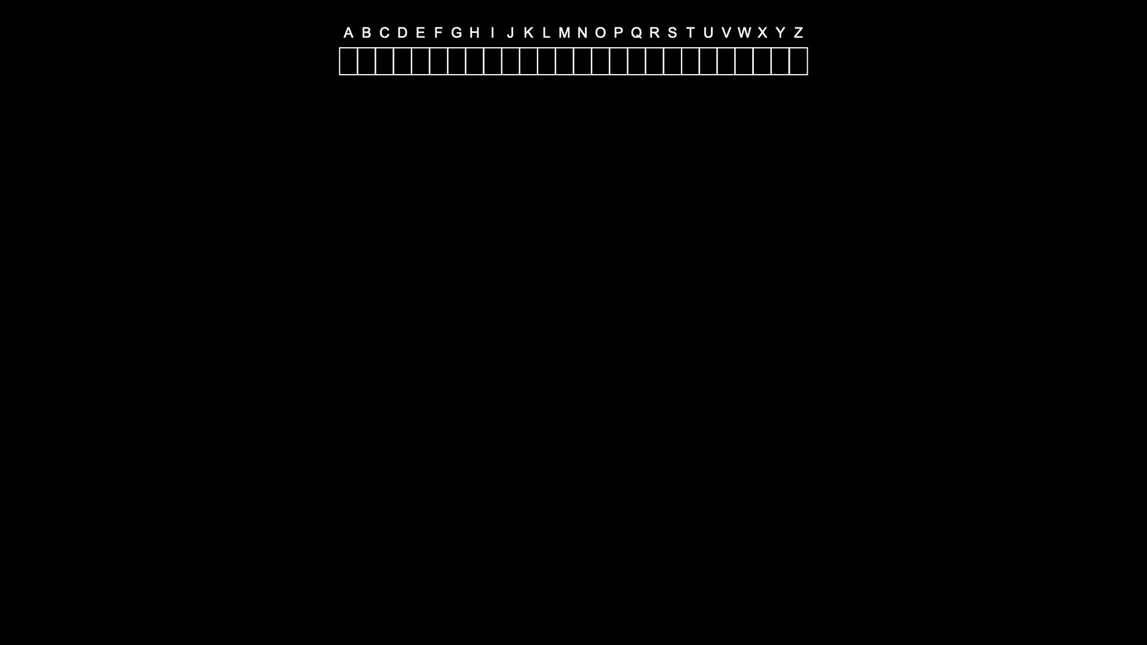
root of trie

Slide 182
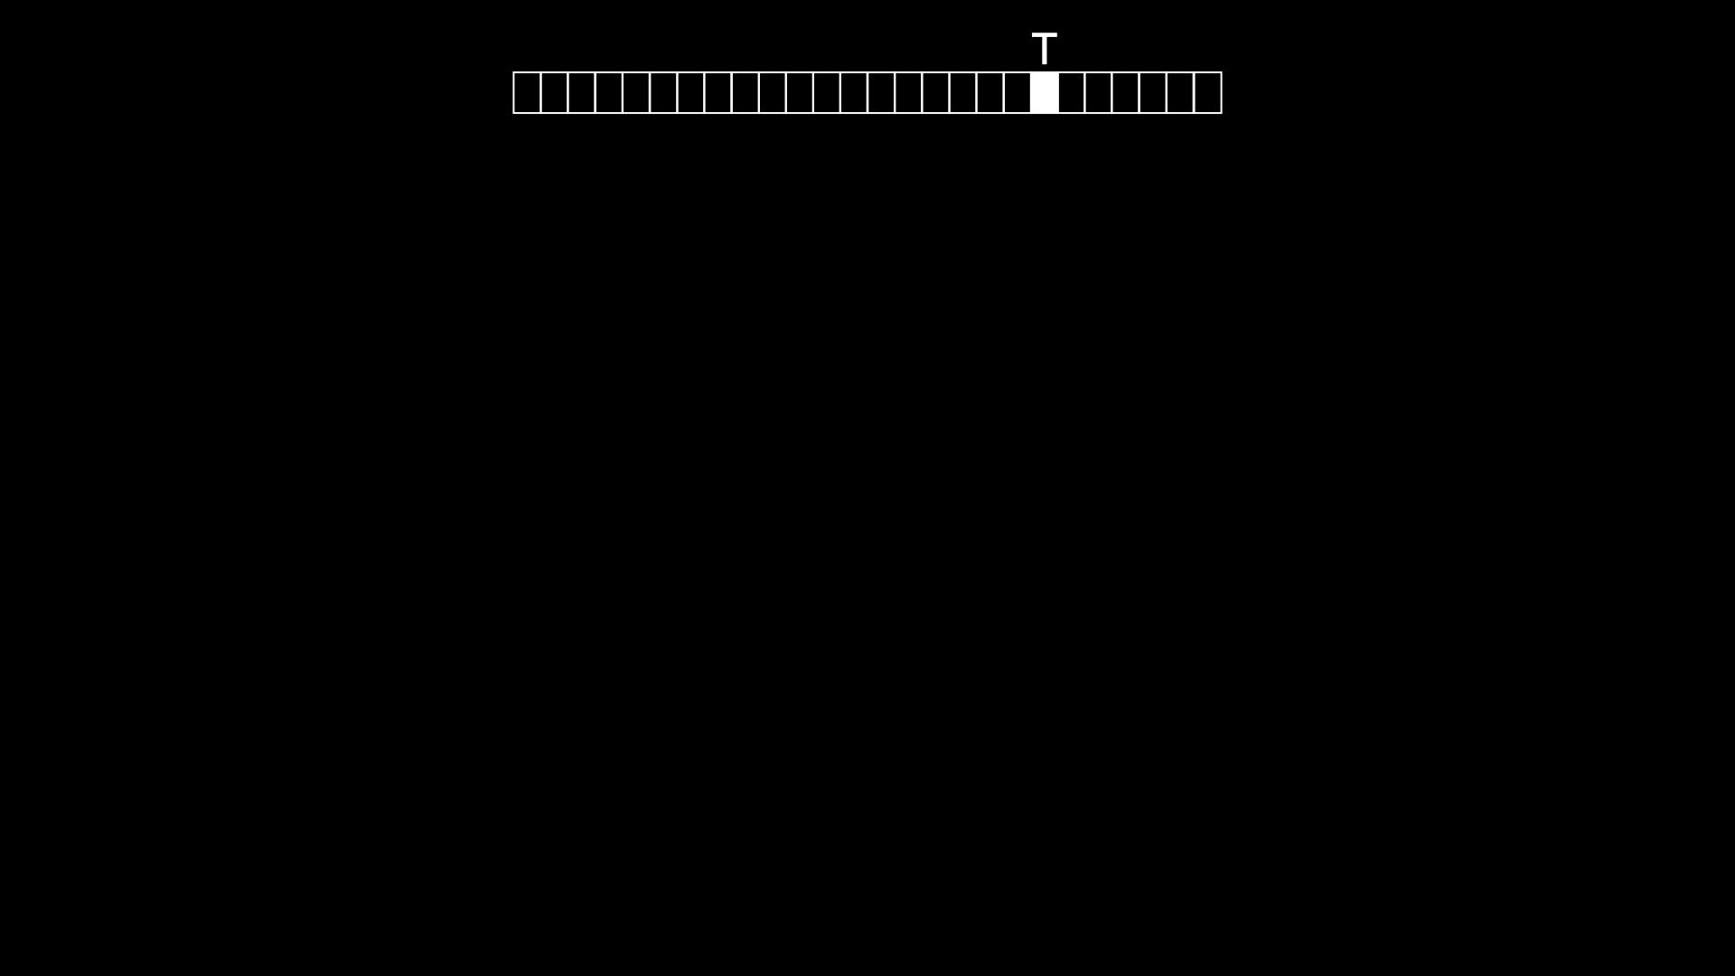
root of trie

Slide 183
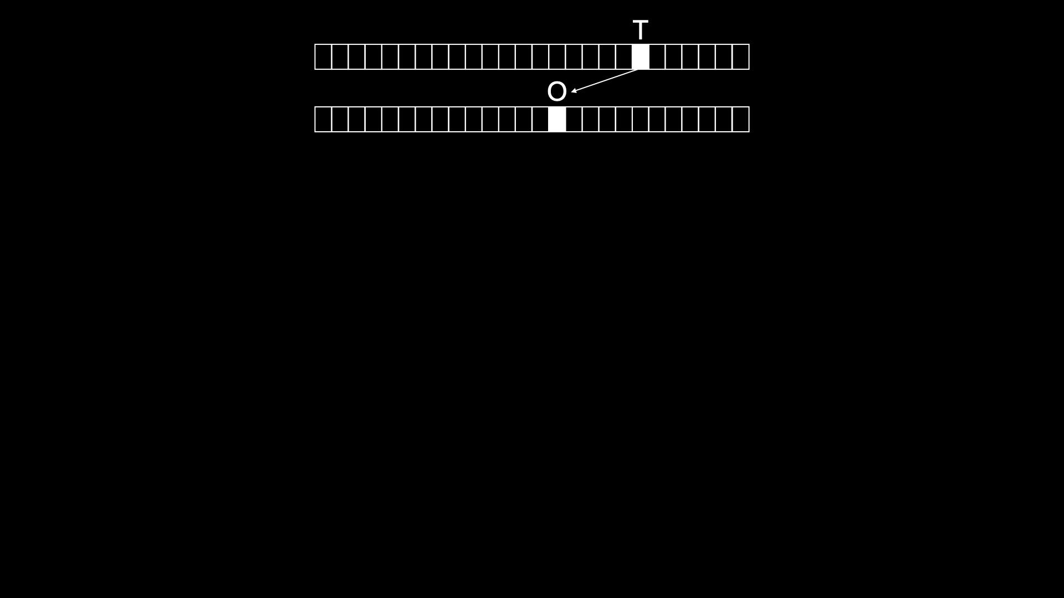
root of trie

Slide 184
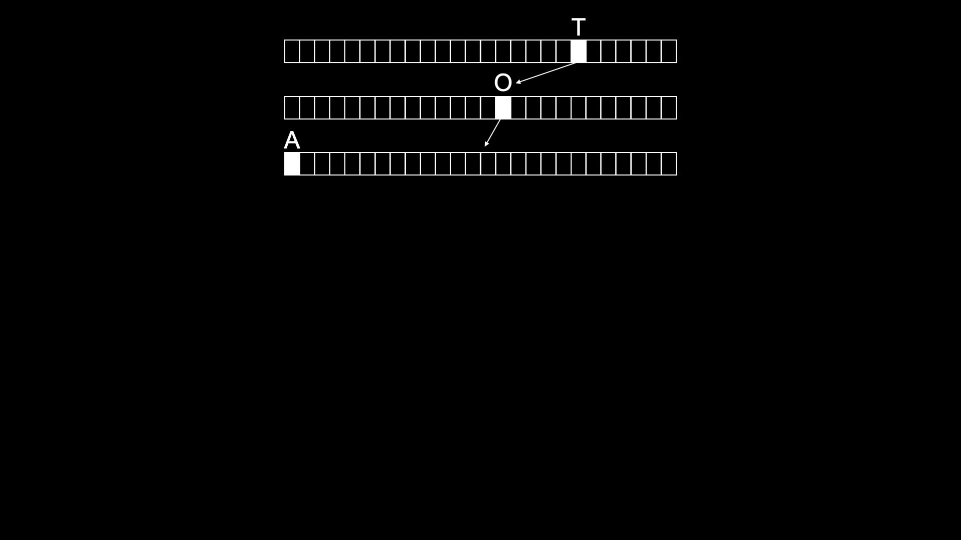
root of trie

Slide 185
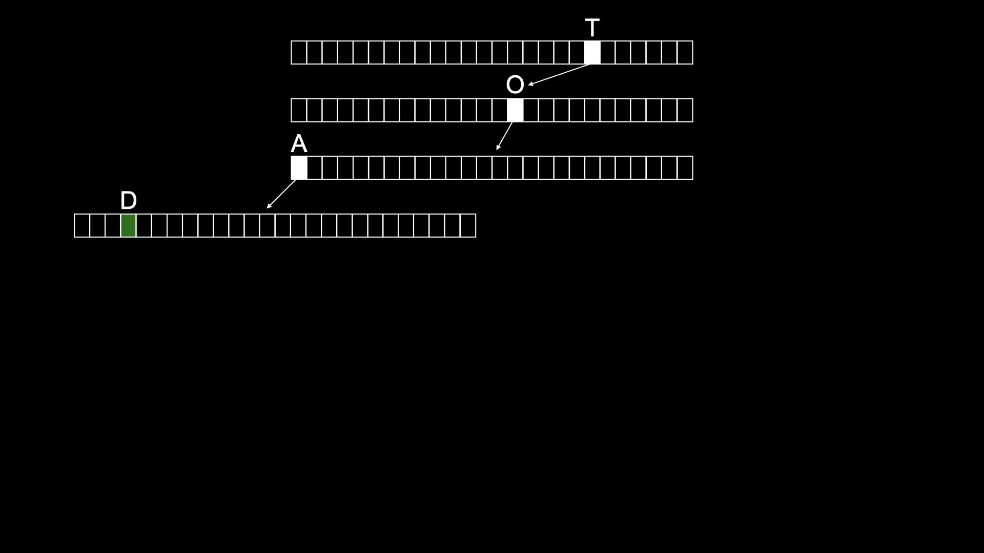
root of trie
TOAD
is the key for this green part of data structure
all values for TOAD lives here

Slide 186
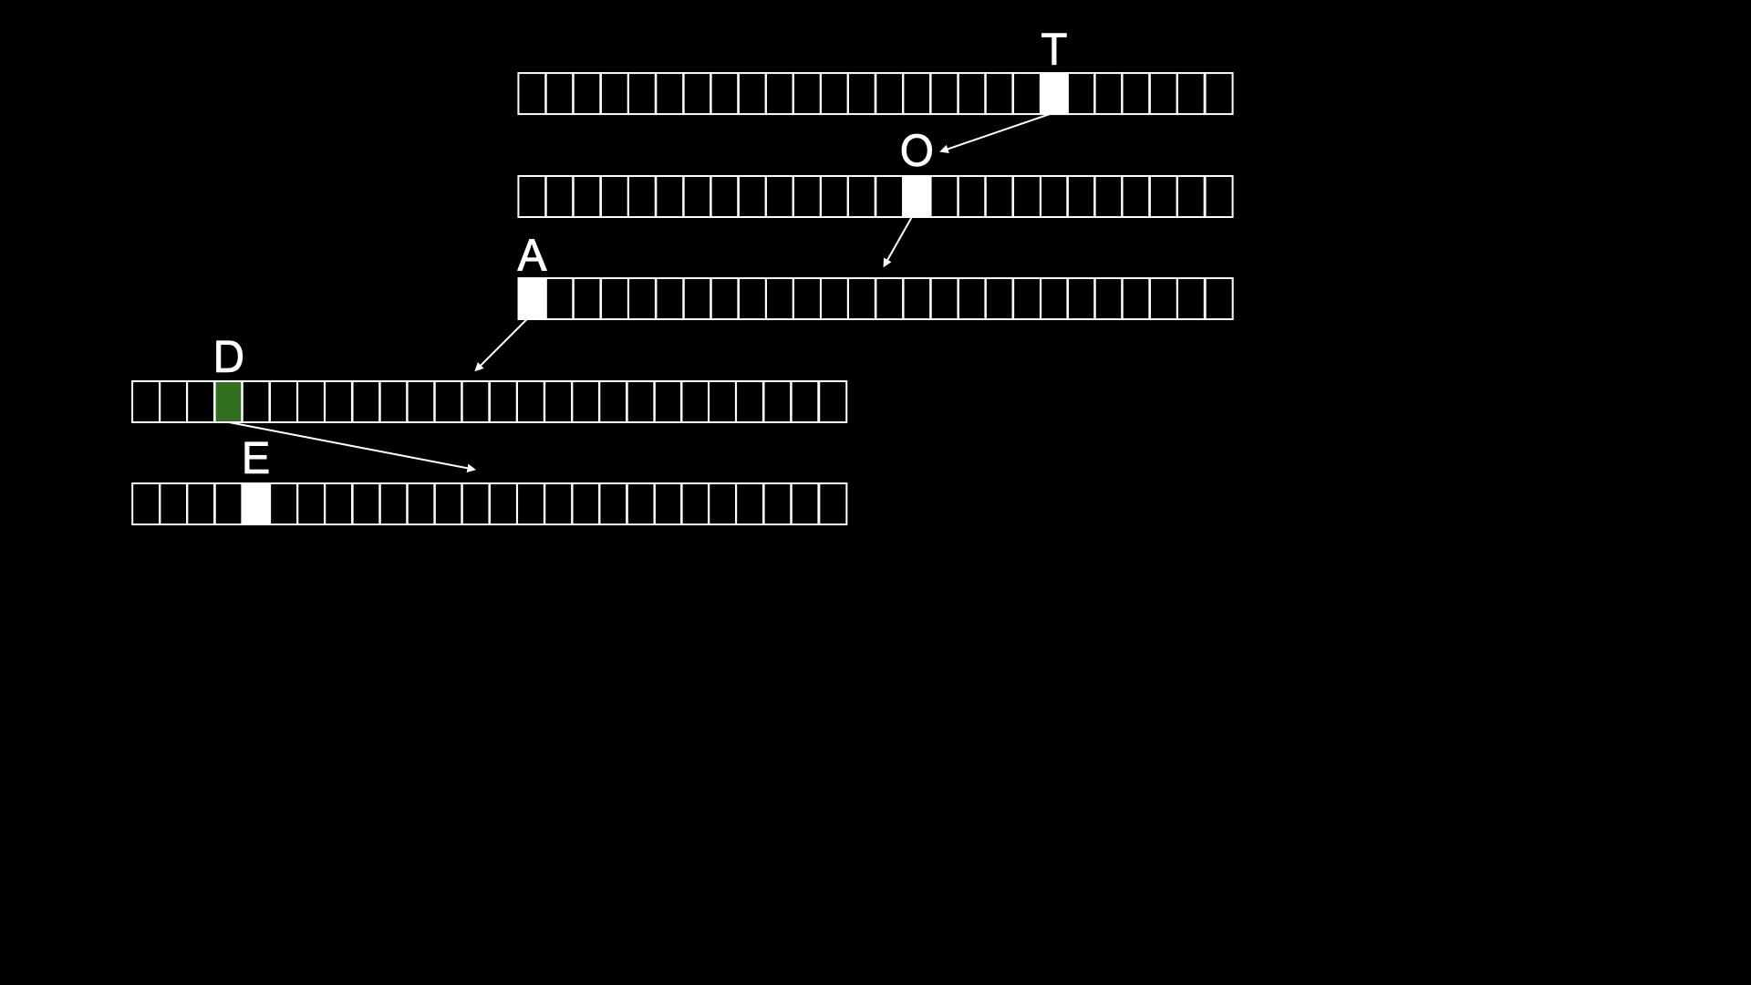
root of trie

Slide 187
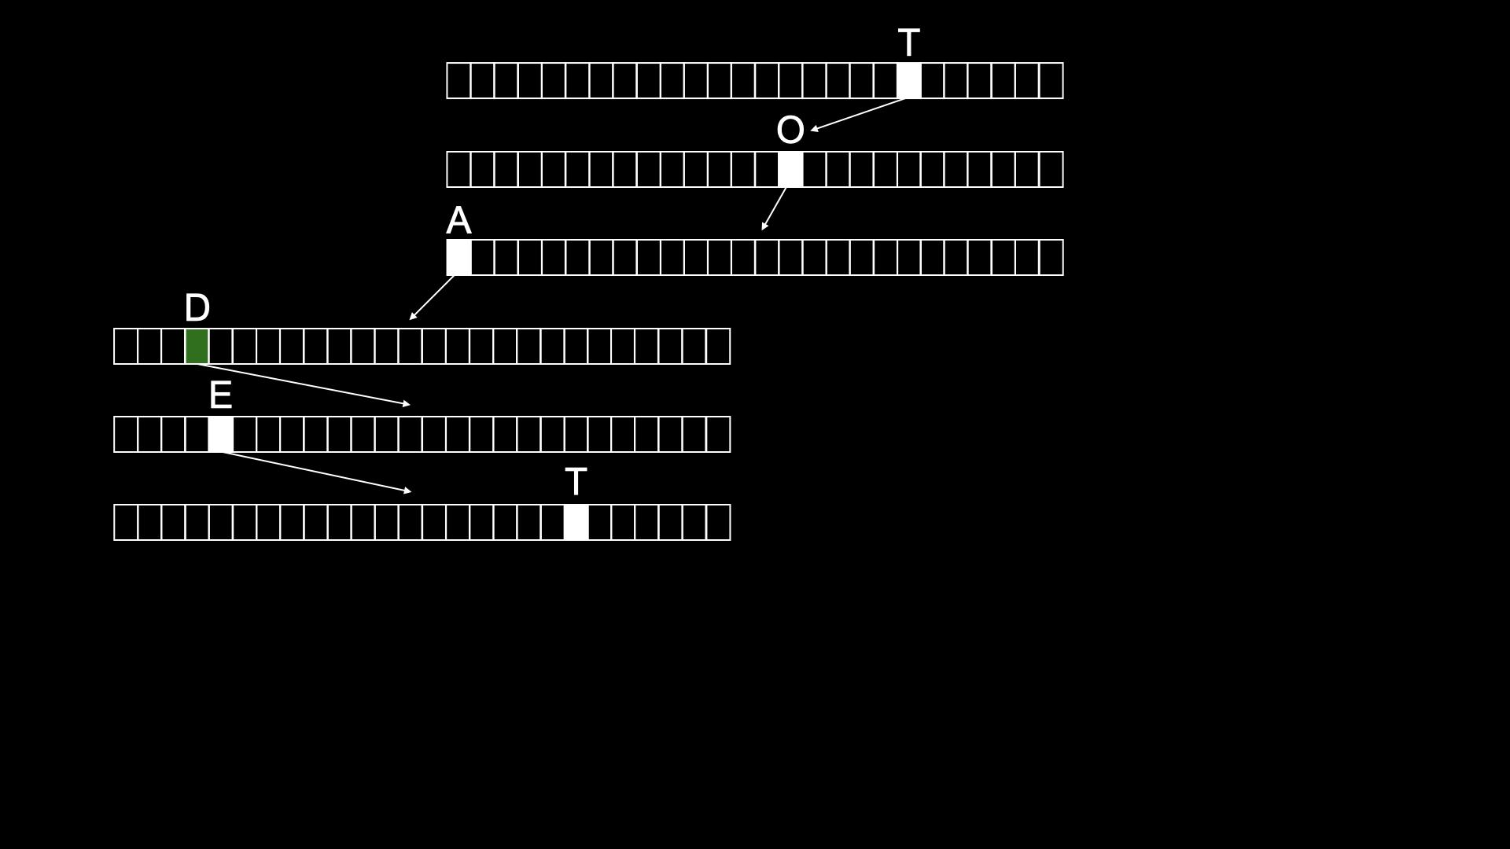
root of trie

Slide 188
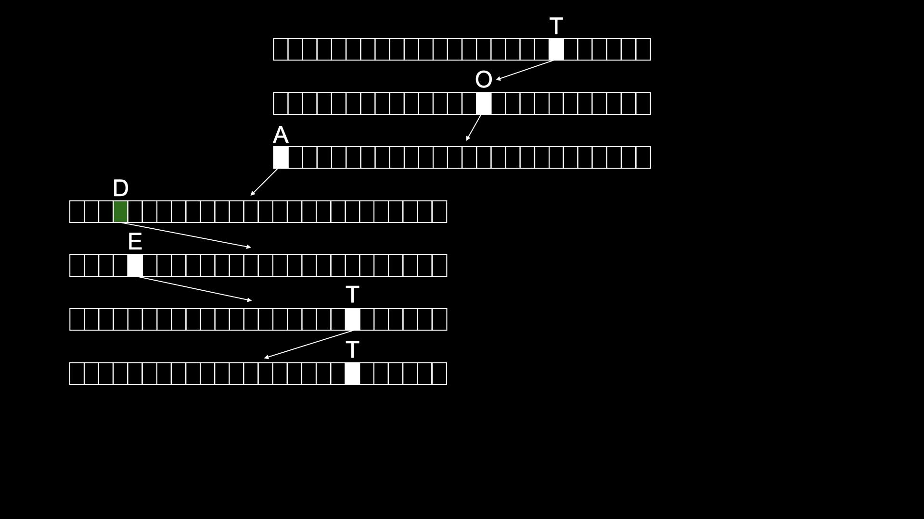
root of trie

Slide 189
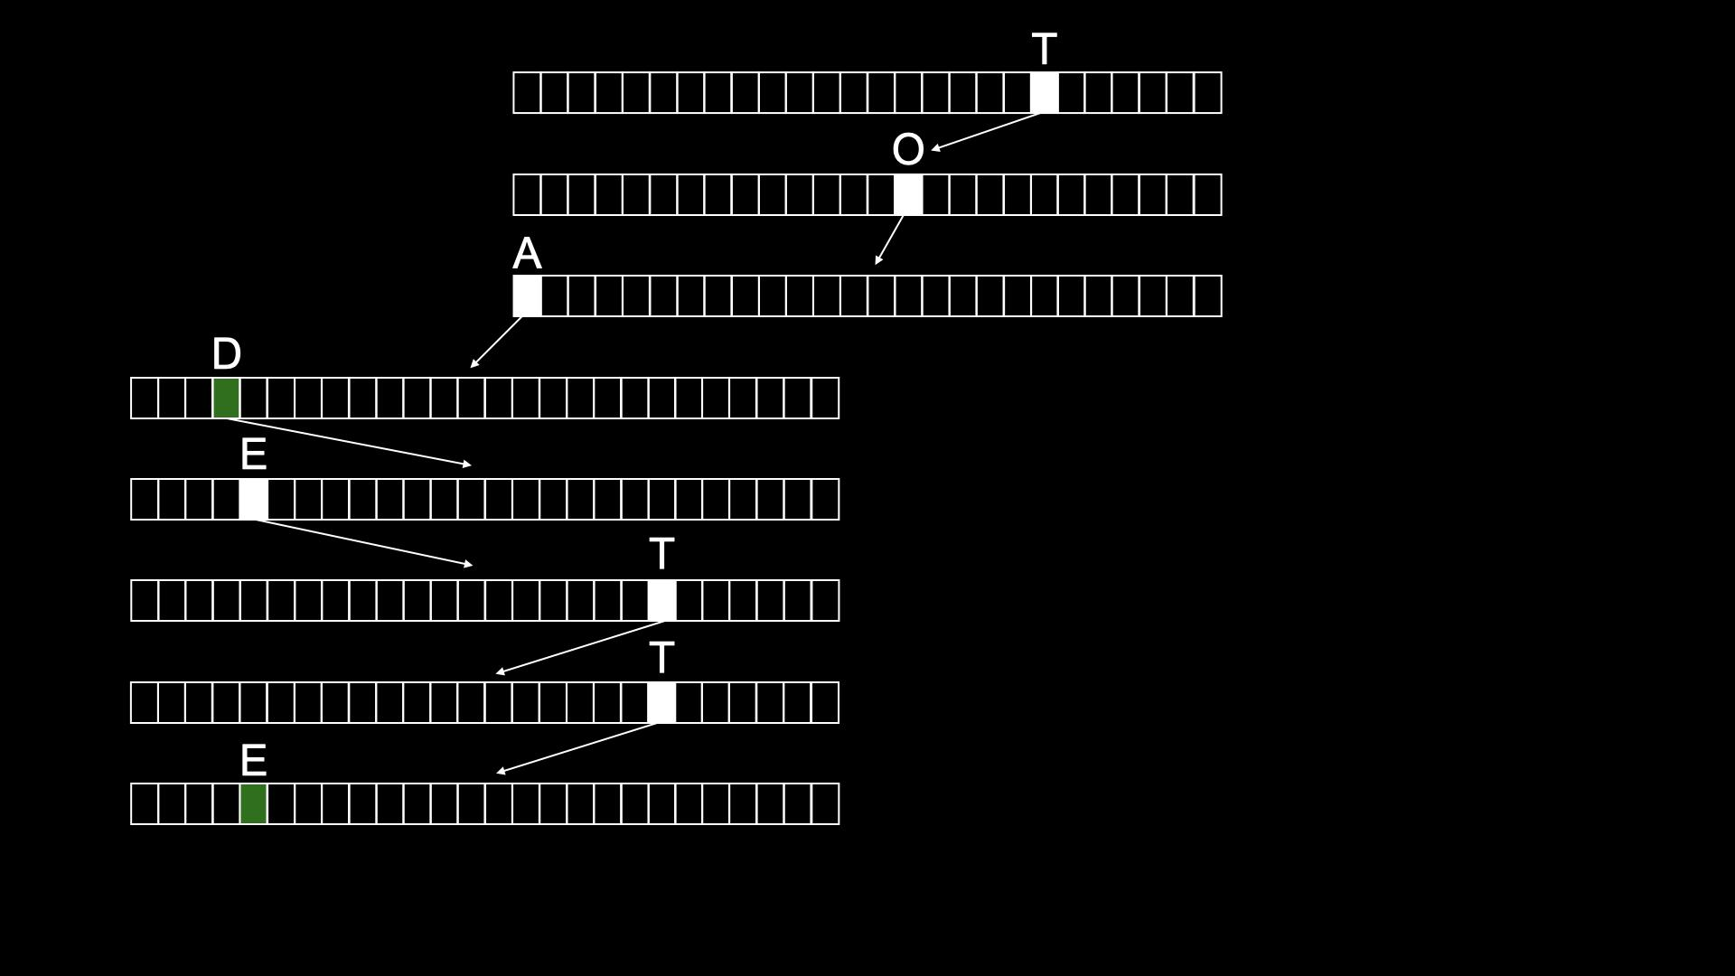
root of trie
TOAD
TOADETTE

Slide 190
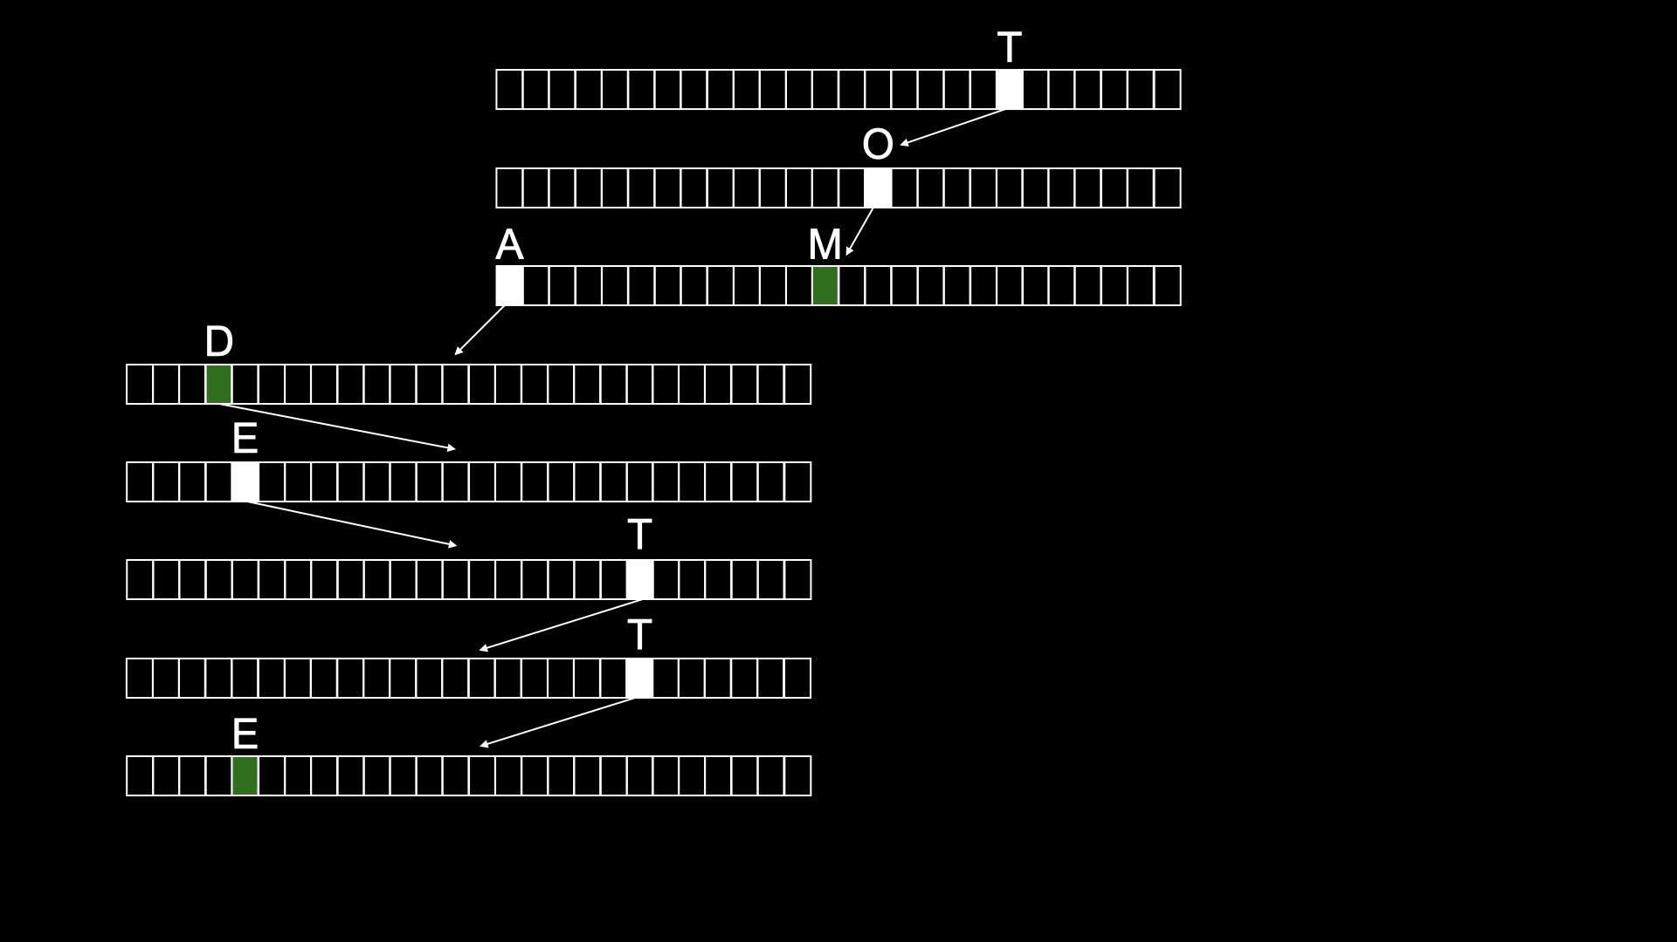
root of trie
TOAD
TOM
it takes k steps to find anyone’s name
TOAD has 4 steps
TOADETTE has 8 steps
TOM has 3 steps
asymptotically, O(1)
TOADETTE

Slide 191
typedef struct node
{
struct node *children[26];
char *number;
} node;
Notes:
don't need to bother storing name, since implicit in trie

Slide 192
node *trie;

Slide 193
O(n²)
O(n log n)
O(n)
O(log n)
O(1)

